Slide 1
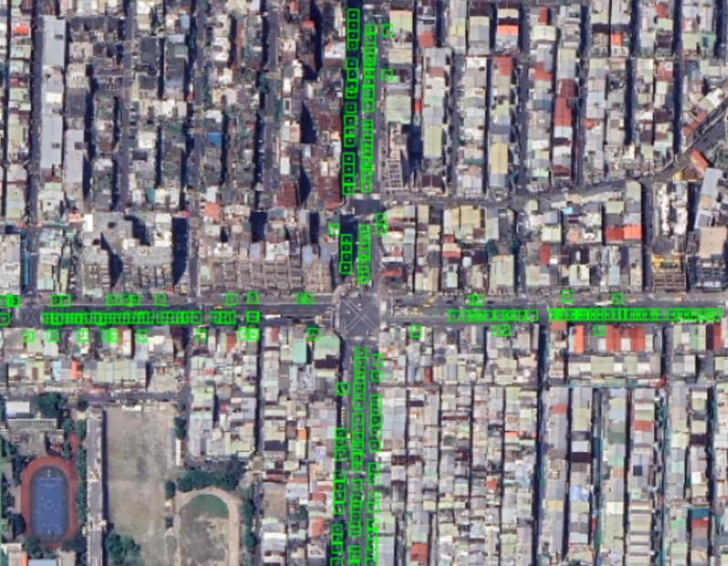

Urban Street Tree Detection
In Taipei City
-1-

Slide 2
Table of Contents
Introduction
Related Work
Dataset
Baseline
Main Approach
Result & Analysis
Web Application
3
4~6
7
8
9~14
15~18
19
-2-

Slide 3
Introduciton
Problem Overview:
The key problem we address is whether it is possible to detect the presence and location of trees in urban environments using automated methods.
Why is the problem important:
1. Estimate green coverage percentage in cities.
2. Assess disaster risks (e.g., typhoons, earthquakes)
Differ from the original:
Traditionally, identifying the location of trees has relied on manual field surveys, our goal is to develop an efficient and scalable method that can automatically detect tree locations from remote sensing or street-level imagery.
-3-

Slide 4
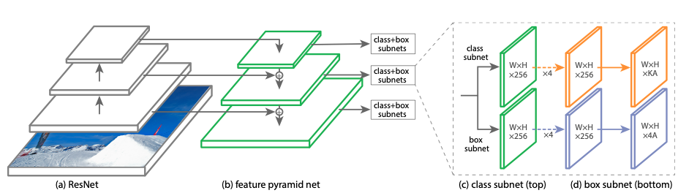
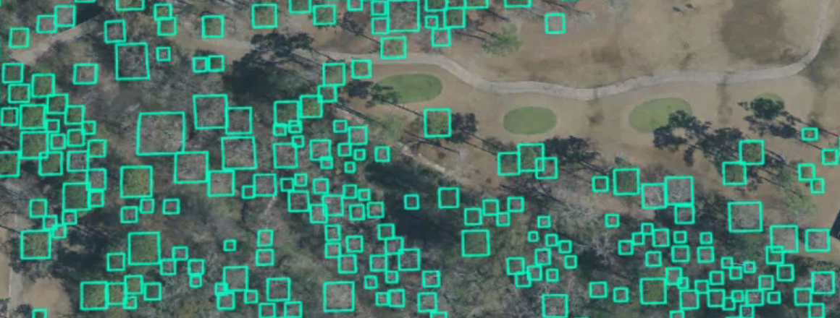
Related Work
Deep learning model to detect trees in high resolution imagery [1]
In this paper. The model is used to detect trees in high resolution drone or aerial imagery. Tree detection can be used for applications such as vegetation management, forestry, urban planning, etc. High resolution aerial and drone imagery can be used for tree detection due to its high spatio-temporal coverage.
RetinaNet Architecure
-4-

Slide 5
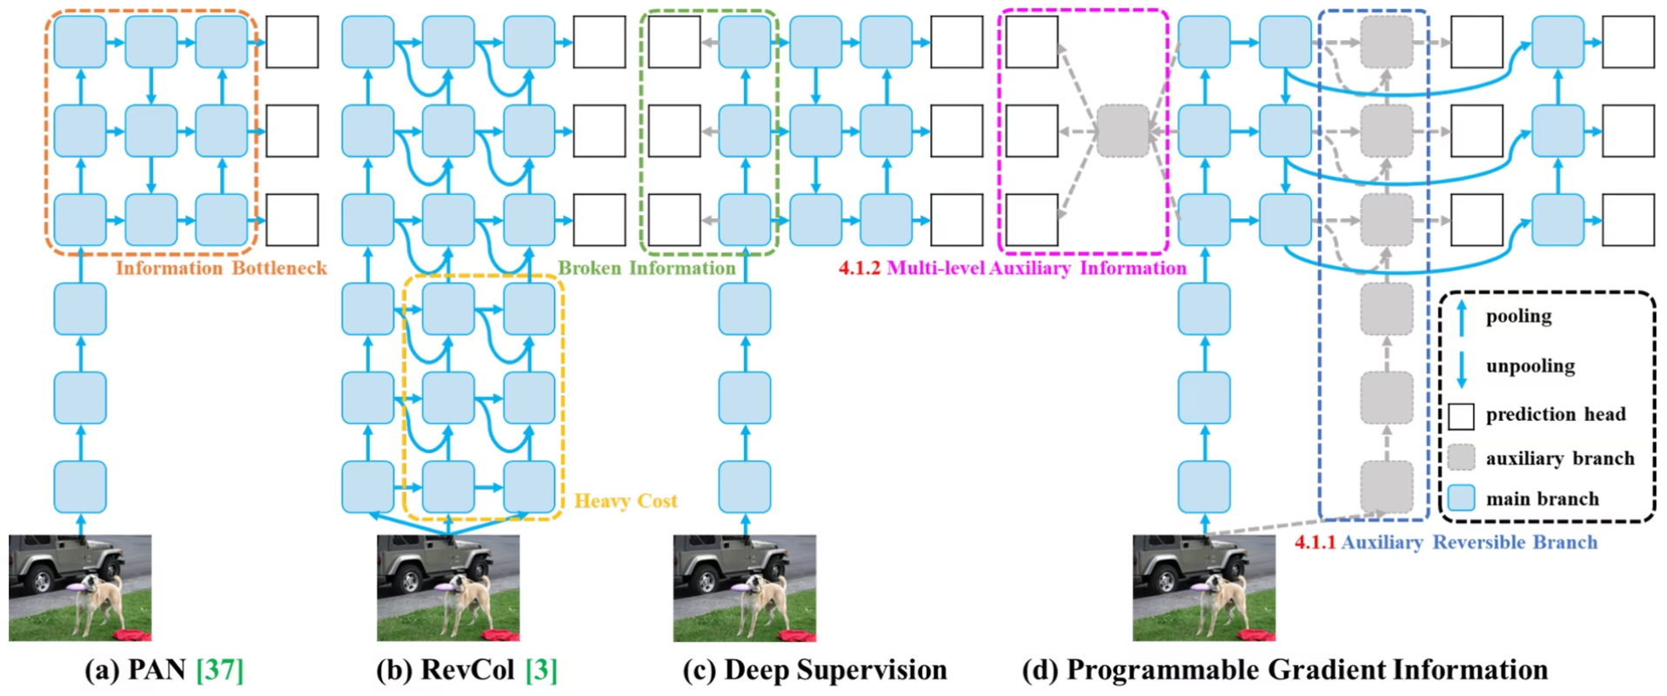
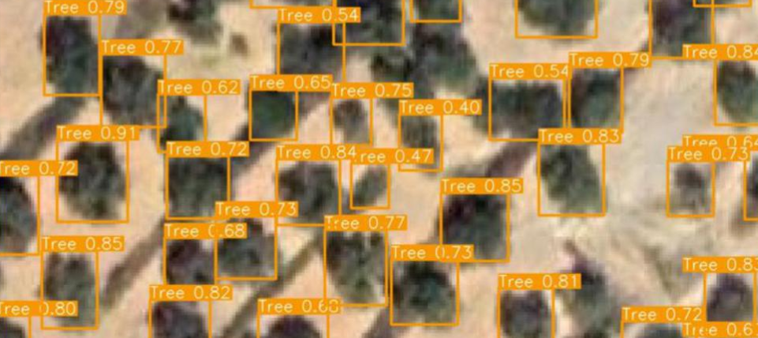
Related Work
VHRTrees: a new benchmark dataset for tree detection in satellite imagery and performance evaluation with YOLO-based models [2]
YOLO v9
Not Designed for Standby Trees
YOLO v9 Architecure
-5-

Slide 6
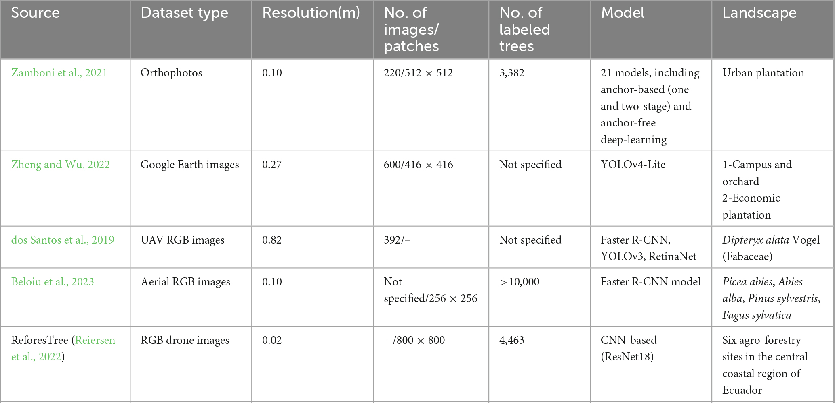
Related Work
-6-

Slide 7
Dataset
Taipei City Government Open Data: Tree location and species
Google Maps Static API: Satellite RGB imagery
Forest Damage – Larch Casebearear: Pretraining on tree detection
IDTReeS: Pretraining on tree detection
Finetuning Dataset for Tree Detection in Taipei
Pretrain Dataset
for Tree Location
-7-

Slide 8
Baseline
Model | Parameter (M) | FLOPs (G)
YOLO v7x | 71.3 | 189.9
YOLO v8s | 11.2 | 28.6
YOLO v8x | 68.2 | 257.8
YOLO v10l | 24.4 | 120.3
YOLO v10x | 29.5 | 160.4
YOLO v11n | 2.6 | 6.5
-8-

Slide 9




Main Approach
Model Adaption
Fine-Tuning
Deploy
-9-

Slide 10
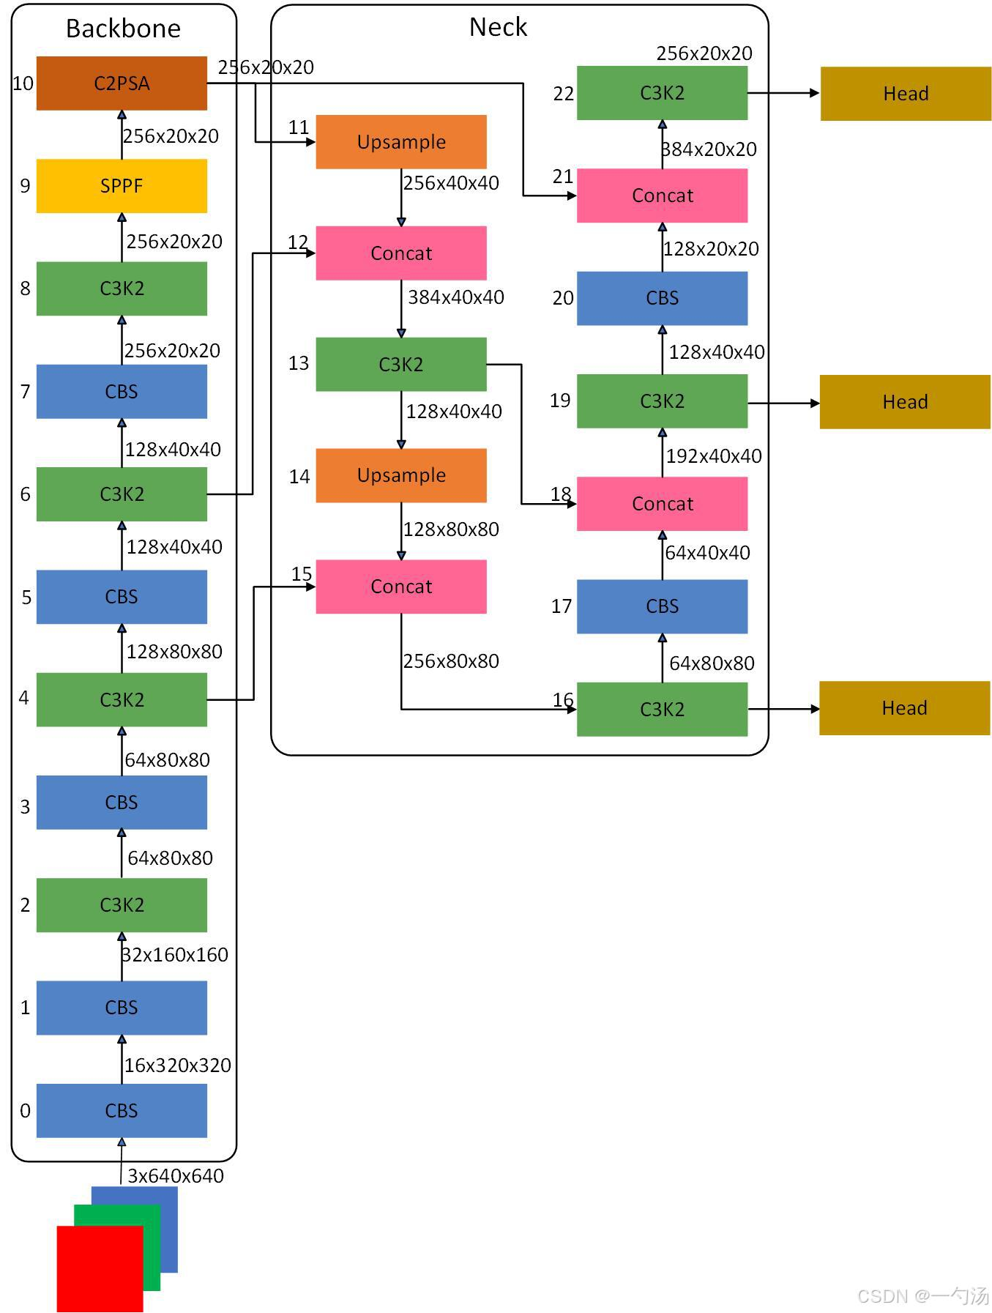
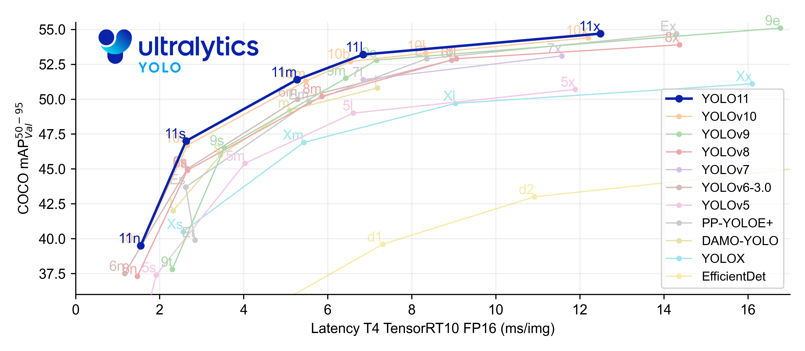
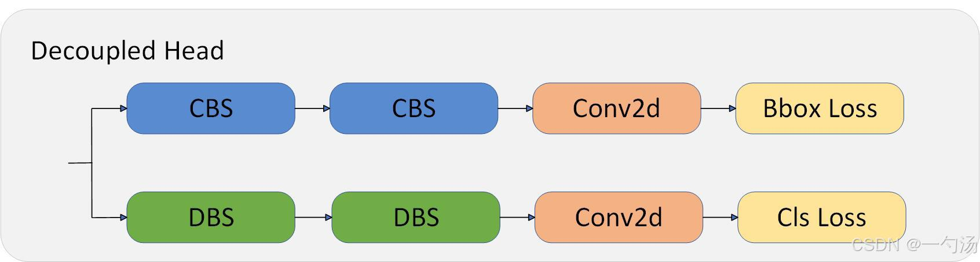
Main Approach
YOLO 11: Better performance, less computational resource [3]
-10-

Slide 11
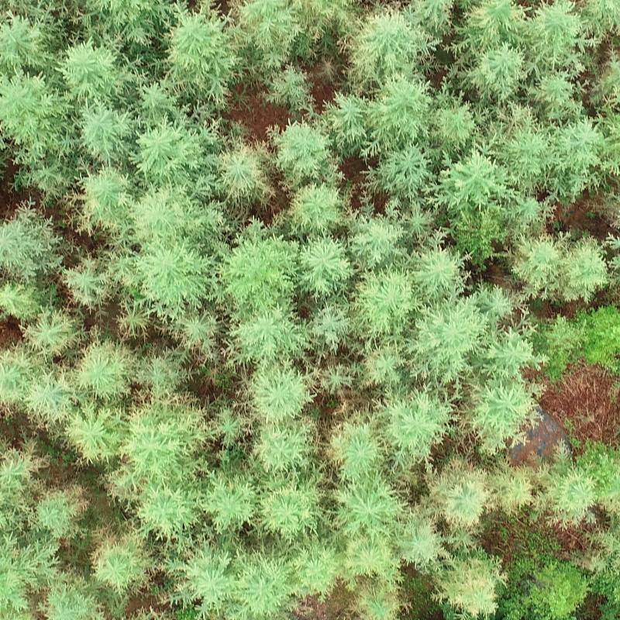
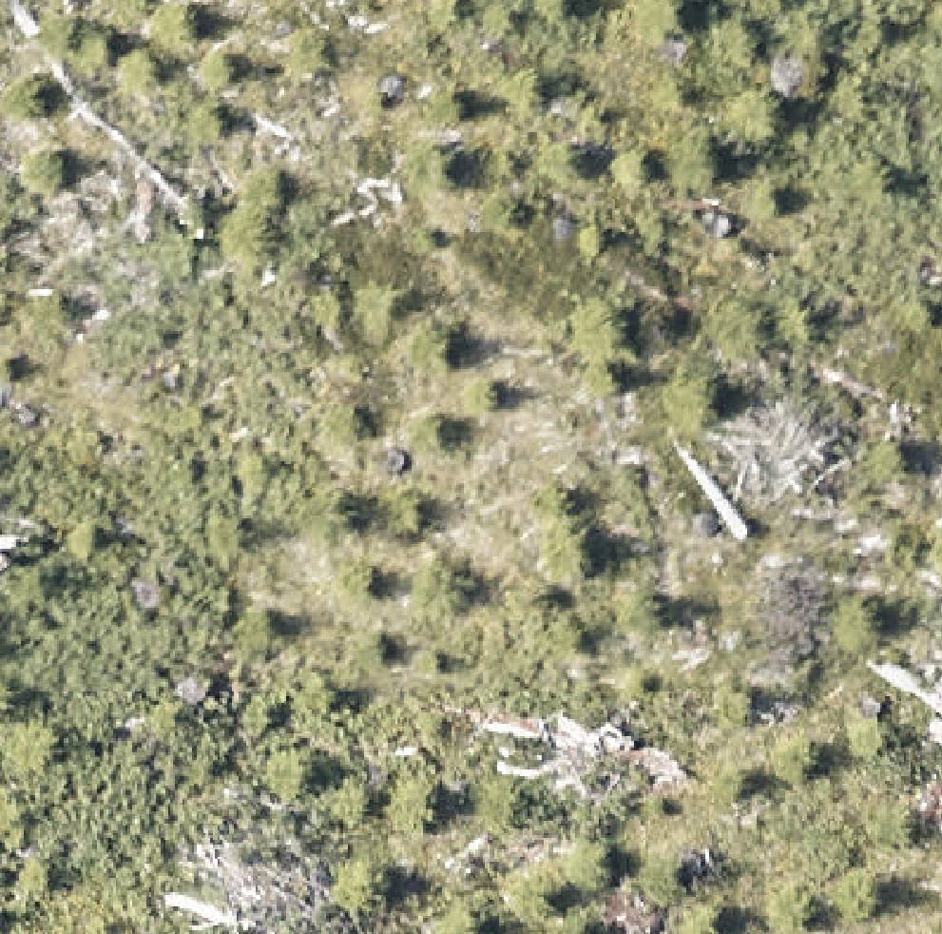
Model Adaption
IDTReeS [4]
Forest Damages [5]
50,381 Aerial Images
33 Tree Species
Annotated Bounding Boxes
Collected in Germany
1,543 Aerial Images
101,878 annotated trees Pascal VOC XML format Collected in Sweden
Pretrain on COCO dataset.
IDTReeS
Forest Damages
Adapt to tree detection task
-11-

Slide 12
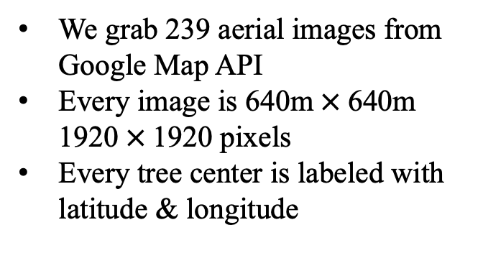
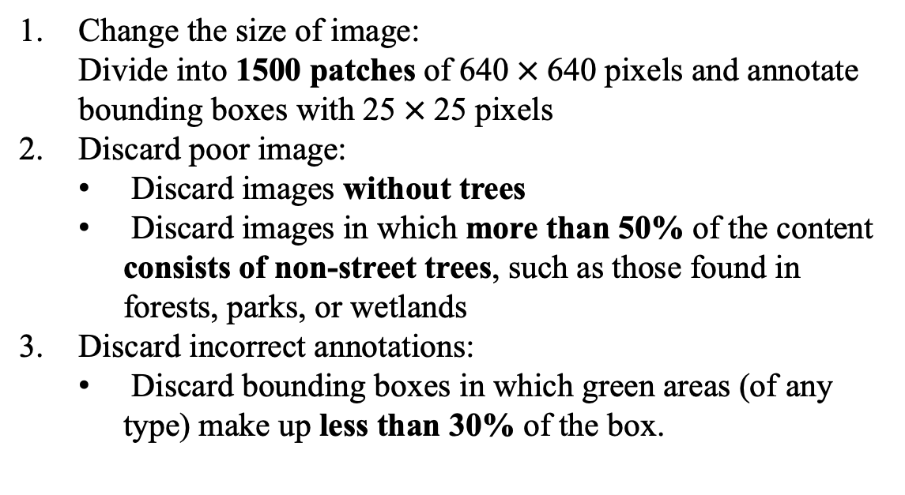
Fine-Tuning
Data Preprocess
Aerial Images in Taipei
Change the size of image:
Divide into 1500 patches of 640 $×$640 pixels and annotate bounding boxes with 25 $×$25 pixels
Discard poor image:
Discard images without trees
Discard images in which more than 50% of the content consists of non-street trees, such as those found in forests, parks, or wetlands
Discard incorrect annotations:
Discard bounding boxes in which green areas (of any type) make up less than 30% of the box.
We grab 239 aerial images from Google Map API
Every image is 640m$×$640m 1920$×$1920 pixels
Every tree center is labeled with latitude & longitude
-12-

Slide 13
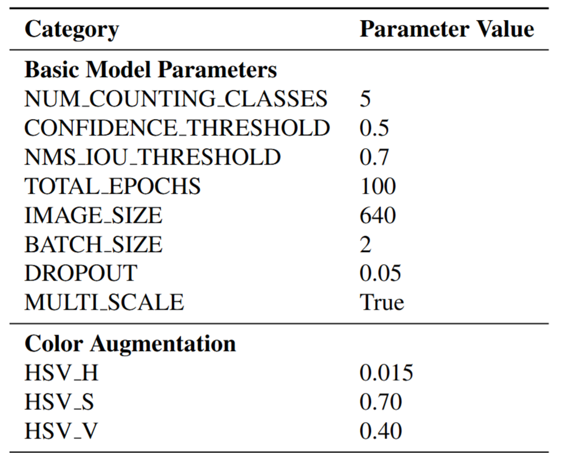
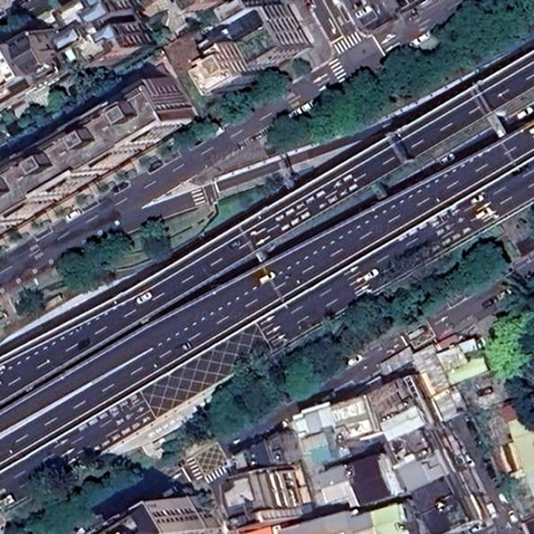
Fine-Tuning
Aerial Images in Taipei
-13-

Slide 14
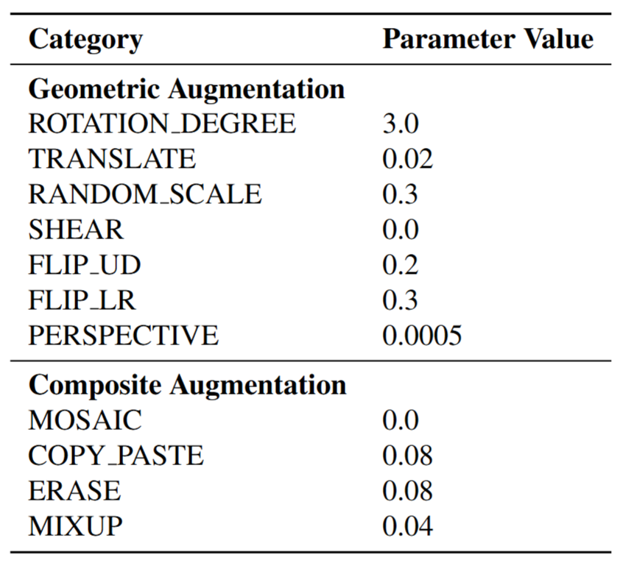
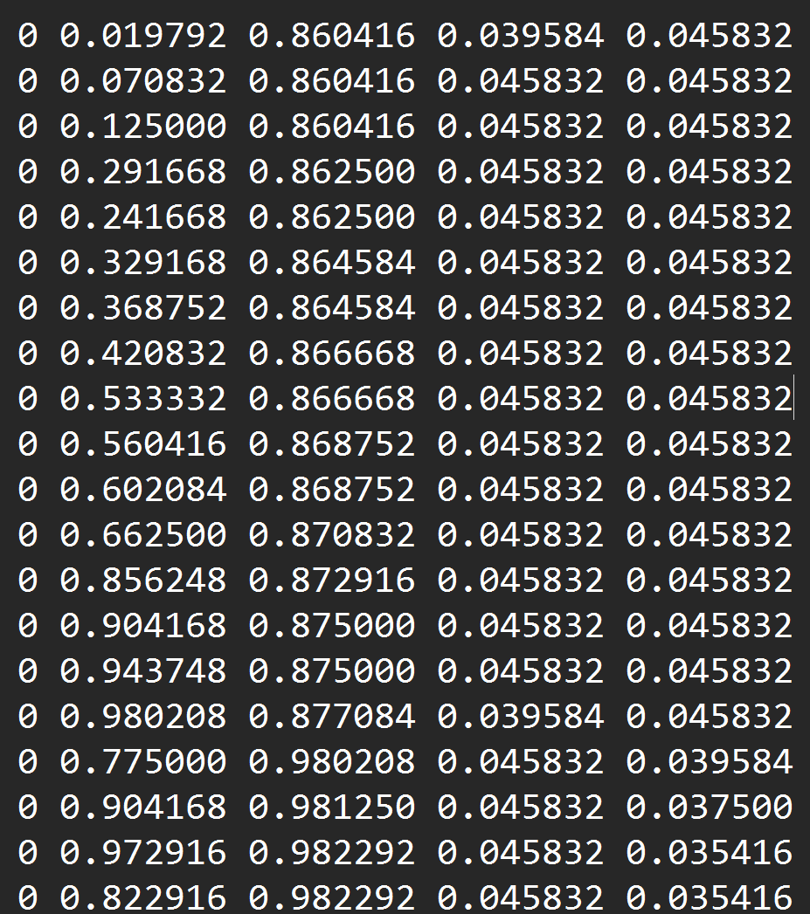
Fine-Tuning
Aerial Images in Taipei
-14-

Slide 15
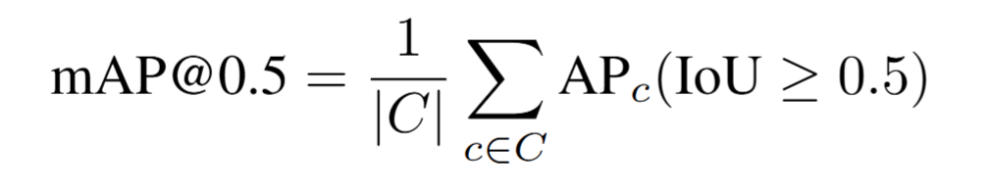
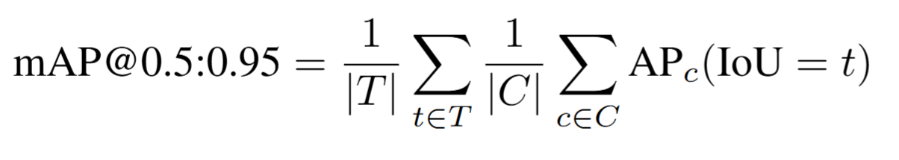
Experiment Metrics
mAP@0.5: Mean Average Precision (mAP) at an IoU threshold of 0.5, meaning a detection is considered correct if the Intersection over Union (IoU) between the predicted and ground truth bounding box is at least 0.5.
mAP@0.5:0.95: Mean Average Precision averaged over multiple IoU thresholds from 0.5 to 0.95 in steps of 0.05.
-15-

Slide 16
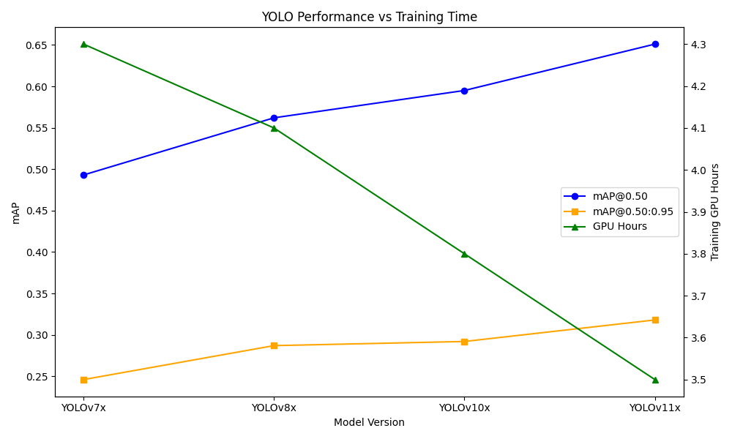
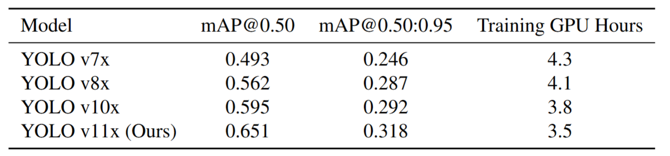
Experiment Results
-16-

Slide 17
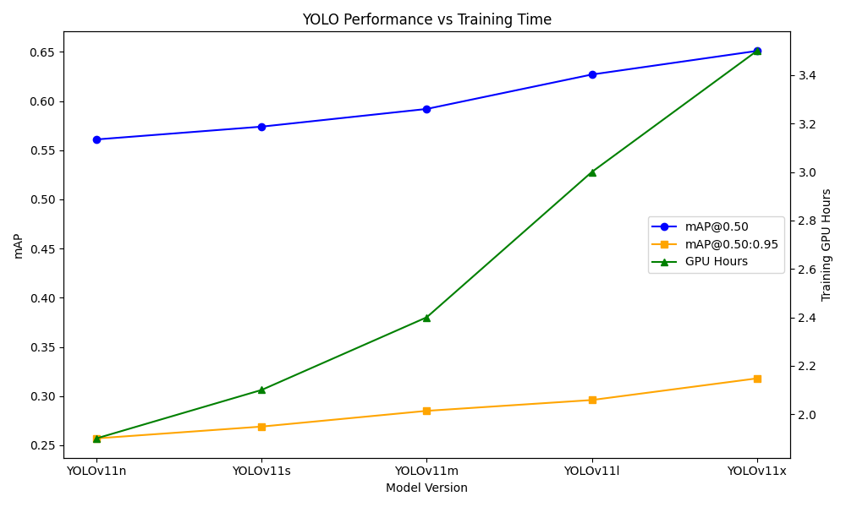
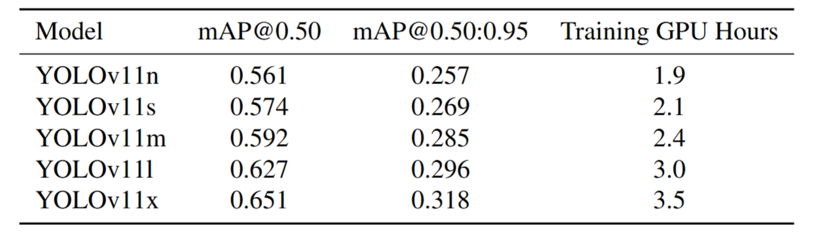
Experiment Results
-17-

Slide 18
Analysis
Different dataset has different formats
We convert all tree detection data to YOLO format and all tree classification data to ImageNet format with CSV annotations
Lack of aerial street images with tree annotations
We designed a three-stage training pipeline:
First, acquiring pre-trained model weights
Second, adapting the model for tree detection
Finally, fine-tuning it with aerial images of Taipei's street trees for task-specific optimization
Poor Data Quality
Taipei City Open Data:
Focused only on street trees; trees in parks or riversides are missing
Google Maps API:
Low resolution and possible image distortions
-18-

Slide 19
Future Work
High-Quality Data Is Key
Need high-resolution aerial imagery
Satellite images often lack sufficient detail
Accurate ground truth labels are crucial
Beyond RGB Bands
Incorporate Near-Infrared (NIR) band
Use NDVI to enhance tree detection
Improve model generalization across cities
-20-

Slide 20
Reference
Weinstein, B.G.; Marconi, S.; Bohlman, S.; Zare, A.; White, E. Individual Tree-Crown Detection in RGB Imagery Using Semi-Supervised Deep Learning Neural Networks. Remote Sens. 2019, 11, 1309
Topgül Ş N, Sertel E, Aksoy S, et al. VHRTrees: a new benchmark dataset for tree detection in satellite imagery and performance evaluation with YOLO-based models[J]. Frontiers in Forests and Global Change, 2025, 7: 1495544.
Ultralytics YOLO Docs
IDTReeS 2020 Competition Data
Forest Damages – Larch Casebearer
-21-

